Slide 1
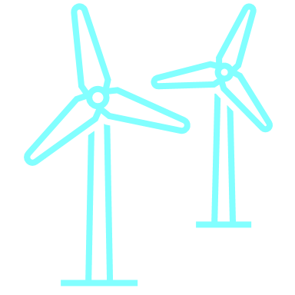
Wind solutions for global climate change
Group 1:
Daniel Saul
Michael Morgan
Max Kimble
Joseph ham

Slide 2


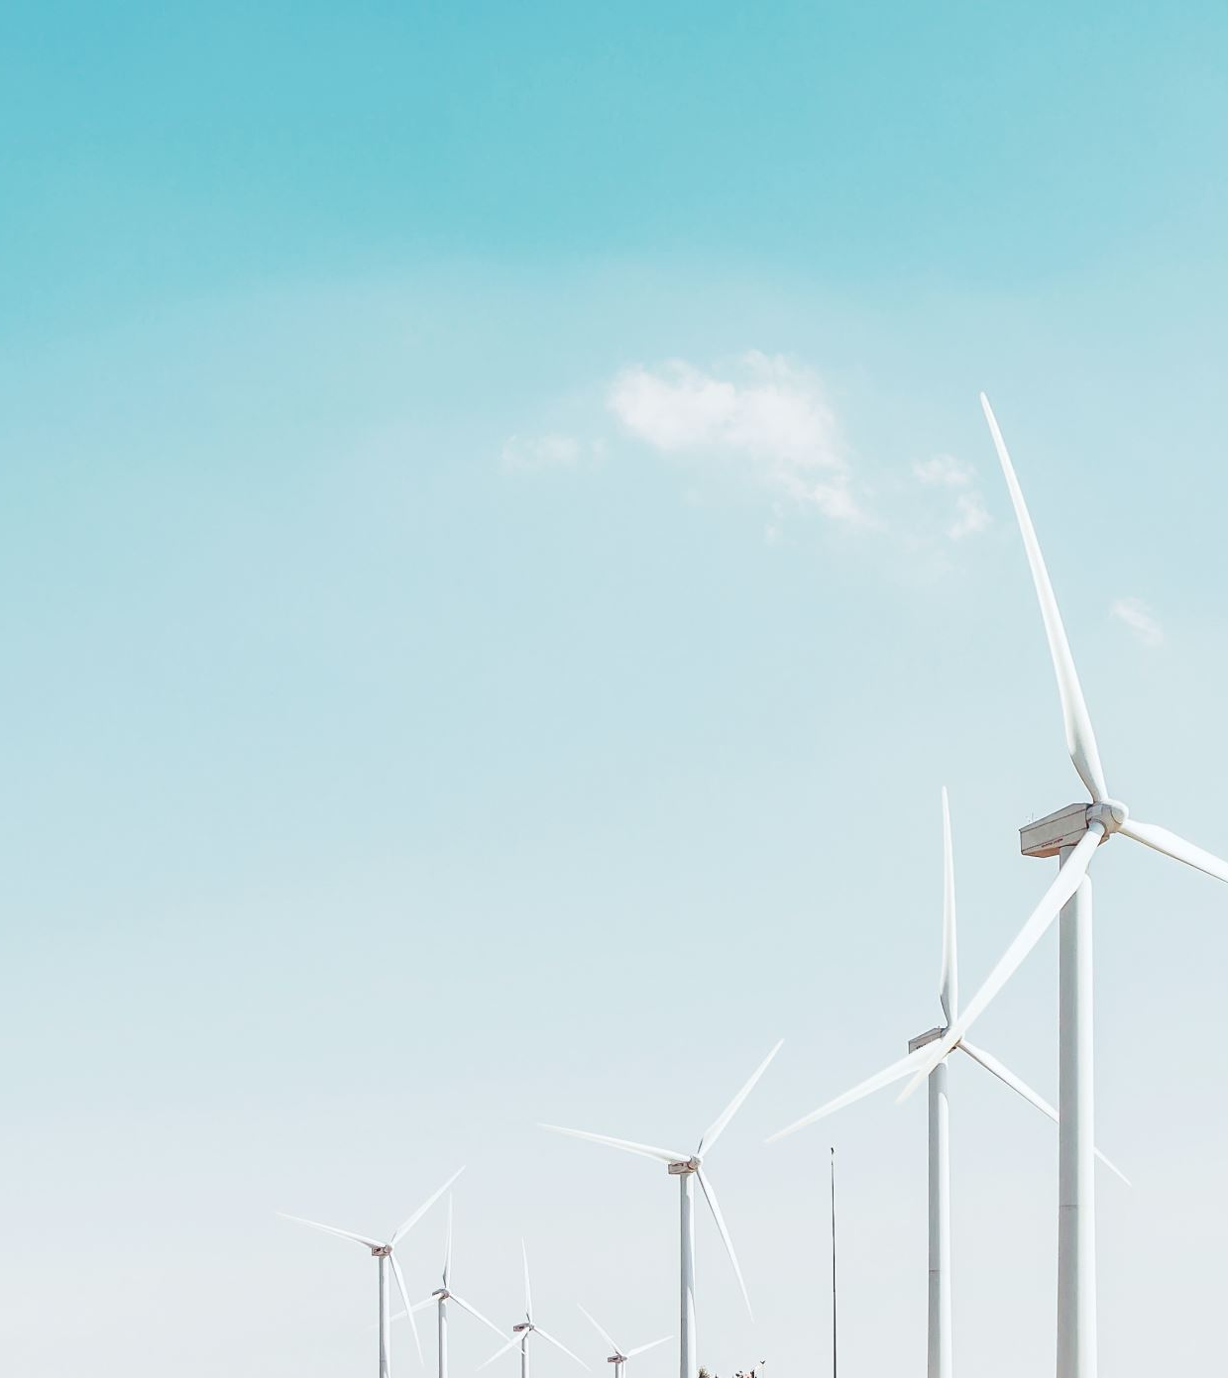
Agenda
The Problem
How It Works
The Solution
Wind Energy Outcomes

Slide 3
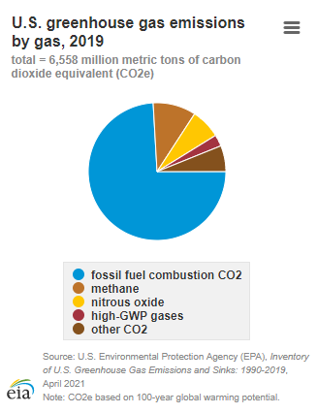
The problem: climate change
Fossil fuels caused 74% of the Greenhouse Gas emissions in 2019 (According to US Energy Information Administration)
Renewable energy sources are needed to bring this number down in order to slow down the rising climate
While cost has been an inhibitor in the past, wind energy has dropped $1000/kwh over the past decade (According to US Department of Energy)
Renewable energy sources still have an intermittency problem
Sources:
https://www.eia.gov/energyexplained/energy-and-the-environment/where-greenhouse-gases-come-from.php
https://www.energy.gov/articles/doe-releases-new-reports-highlighting-record-growth-declining-costs-wind-power
Notes:
Wind is highly intermittent, meaning it has irregular availability. This is due to a number of factors such as wind speed, the weather, air density, and more.
Next steps for renewable energy sources will be solving intermittency issues as much as possible.
Michael

Slide 4
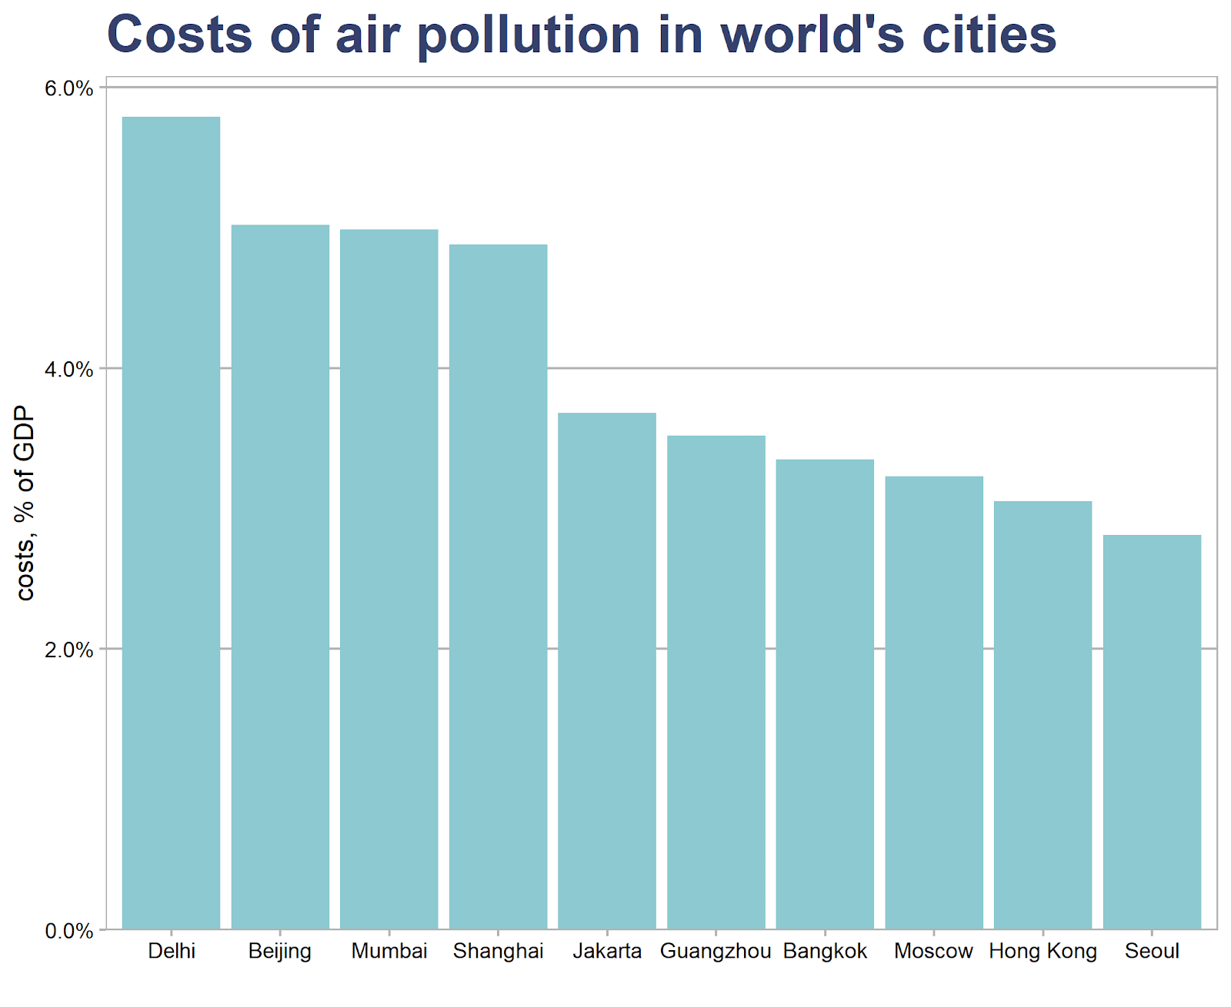
Economic and Health Costs of Non-renewable energy
Economic: As a society we are paying a significant portion of GDP dealing with the impacts of air pollution
Health: These negative impacts are long-lasting, difficult to quantify, and a dangerous issue
Number come from where?
Sick Leave
Asthma
Asthma-related hospital trips
Years of life lost
Etc.
Notes:
Fossil fuels will be replaced by Wind Technology and these impacts will be aleviated.
Economic impacts due to fossil fuels
Shock factor of inforgraphic
Health impacts
Where these numbers come from

Slide 5
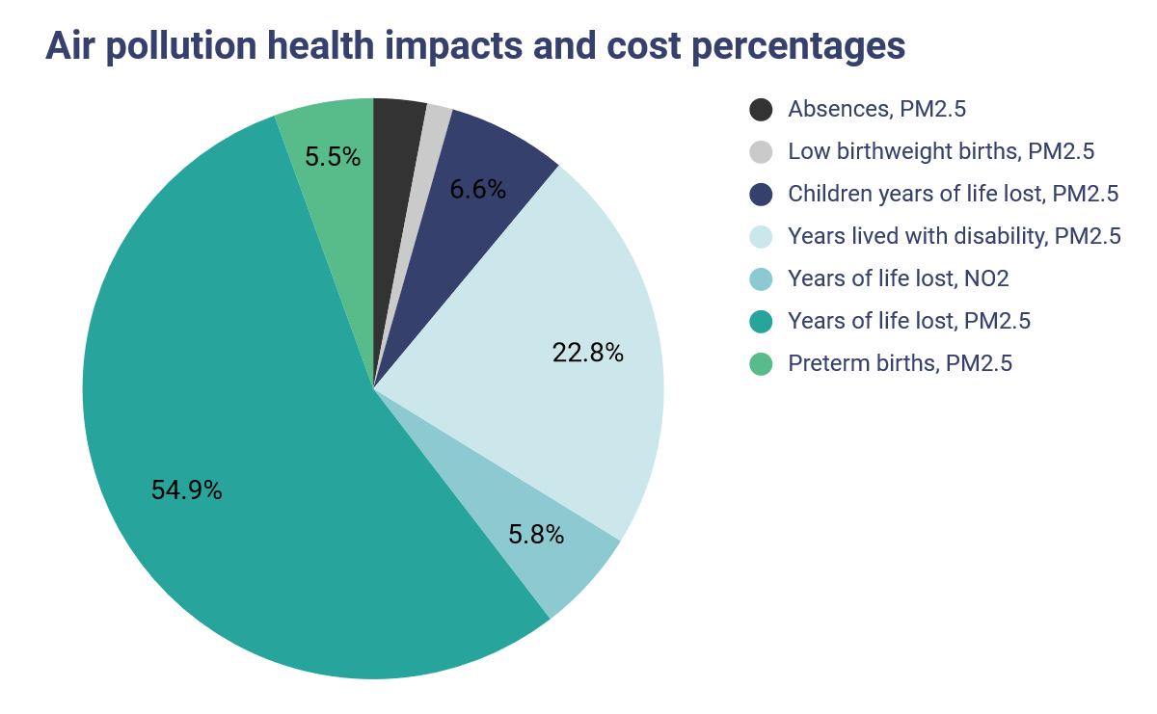
Cont'd
New Delhi:
4000 new cases of asthma reported due to NO2 pollution
PM2.5 exposure has led to over 15,000 asthma-related emergency visits
Cost of children's lives lost due to PM2.5 reach $310 million
Total Cost of Air Pollution: 3.5 billion
Notes:
Explain the graphic
Cover the New Delhi topics
Mention 2020
Now that we covered some economic and health impacts of our current Fossil Fuel reliant system, I will pass it on for us to talk about how Wind Technology works and how it can help

Slide 6
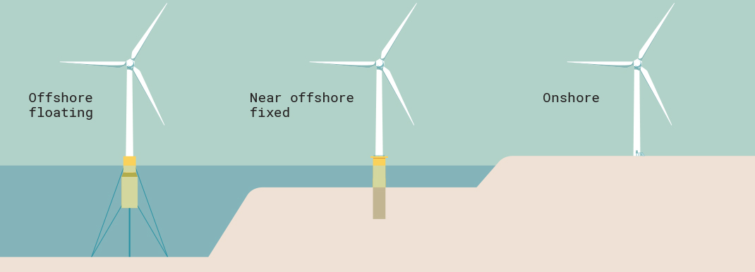
How wind technology works
Main types of turbines:
12 million kWh per year
6 million kWh per year
Source: https://www.inspirecleanenergy.com/blog/clean-energy-101/how-much-energy-does-wind-turbine-produce
Notes:
Offshore wind turbines have different base structures connecting to the earth floor
Offshore turbines are typically more expensive, but yield more energy output
6 million kWh per year is enough to power 1,500 EU homes

Slide 7
How wind technology works Cont.
Pros:
Renewable energy where available
Wind is a free and unlimited source
Cons:
Location-dependent where winds are strong and consistent
Higher construction and maintenance cost
Requires large amounts of space and land
Source: https://mocomi.com/how-do-wind-turbines-work/
Notes:
Wind turns the giant blades which are connected to the rotor, powering the generator, and moving wind into electrical energy
Some pros: it is a renewable energy where wind is available with no waste
Some cons: location-dependent where winds are the strongest and most available, high construction and maintenance costs

Slide 8
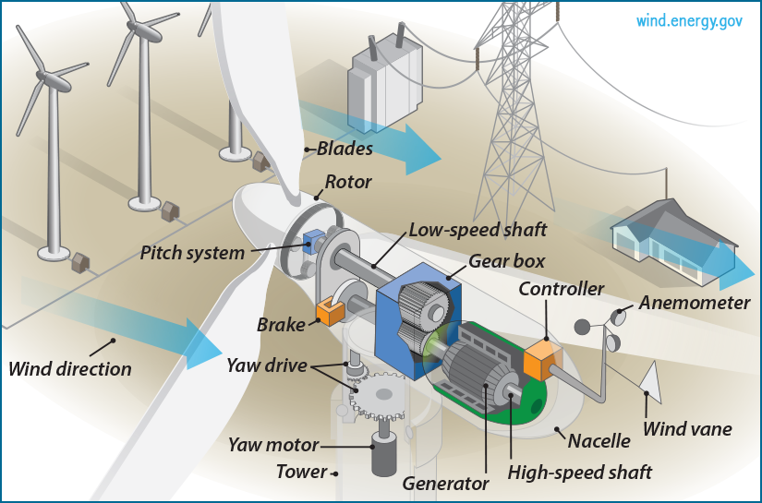
How wind technology works cont.
Wind force turns the blade, generating mechanical energy, and turning the internal shaft
The mast supports the rotor and nacelle; the nacelle contains the mechanical parts
The rotor is connected to a generator through a series of gears so that the rotational speed is increased in the order of 100 times.
This enables the generator to produce electricity and not be too large and expensive.
Computers control the pitch of the blades and the direction they point to produce maximum power.
Source: https://sites.psu.edu/siowfa15/2015/09/18/how-do-wind-turbines-work/
Source: https://www.inspirecleanenergy.com/blog/clean-energy-101/how-much-energy-does-wind-turbine-produce

Slide 9
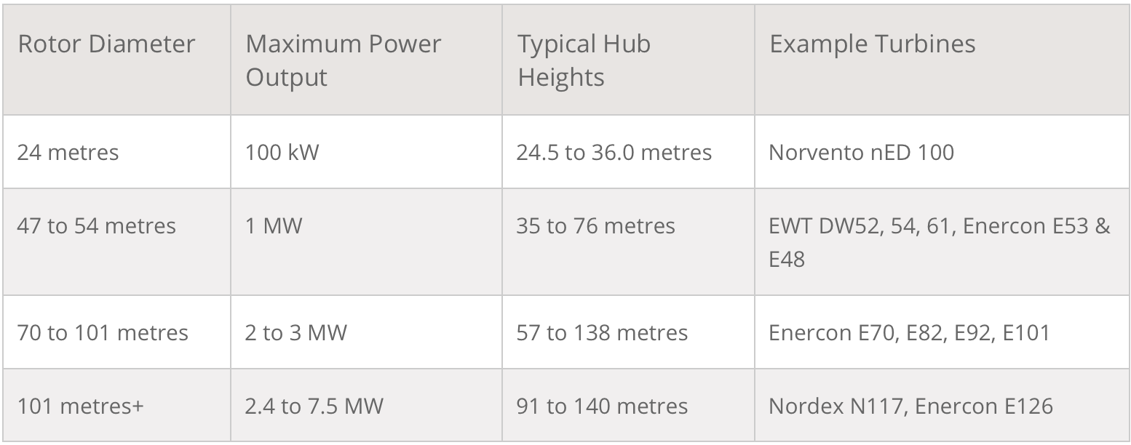
How wind technology works Cont.
Wind turbine blade size and power output
Source: https://www.renewablesfirst.co.uk/windpower/windpower-learning-centre/much-power-generate-wind-turbine/

Slide 10
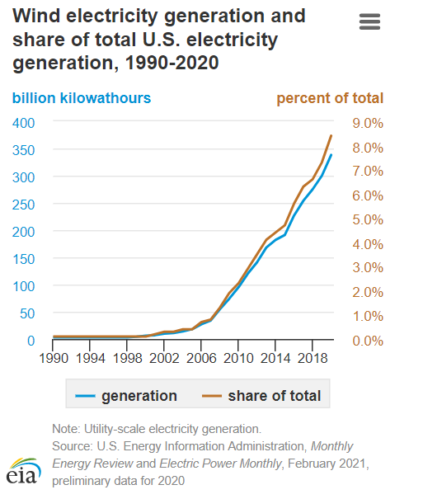
Wind energy solution to climate change
Wind energy has the largest renewable share of total US electricity generation today
Wind is cheap, low maintenance energy source that creates less GHG emissions than solar
Challenges such as intermittency and transportation of the energy remain
Notes:
While Wind Energy is not the catch-all solution, it is making a significant positive impact in the energy sector.
Spoke about intermittency earlier,
Michael

Slide 11
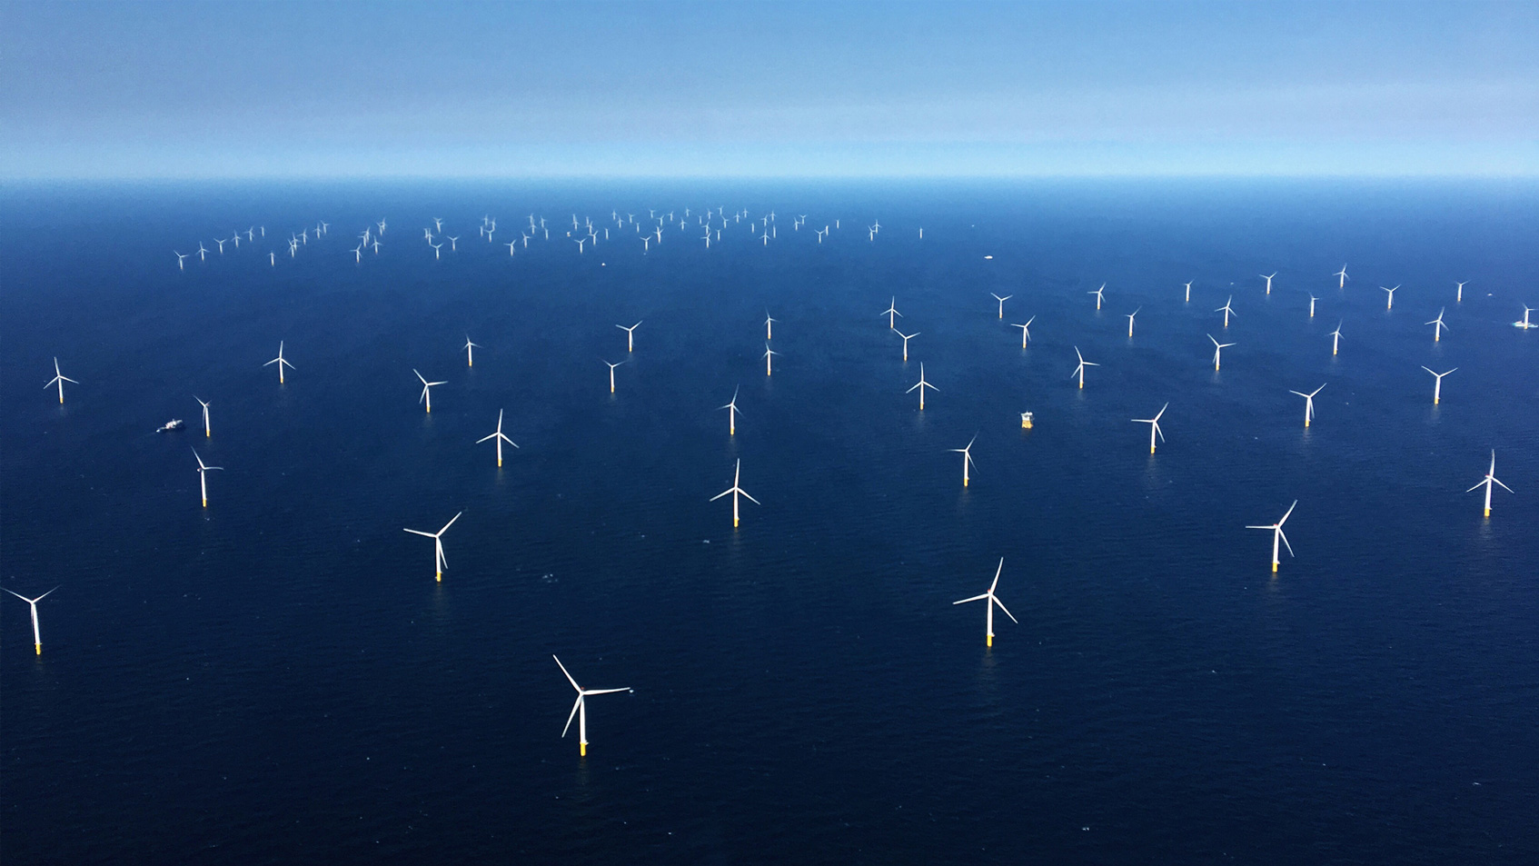
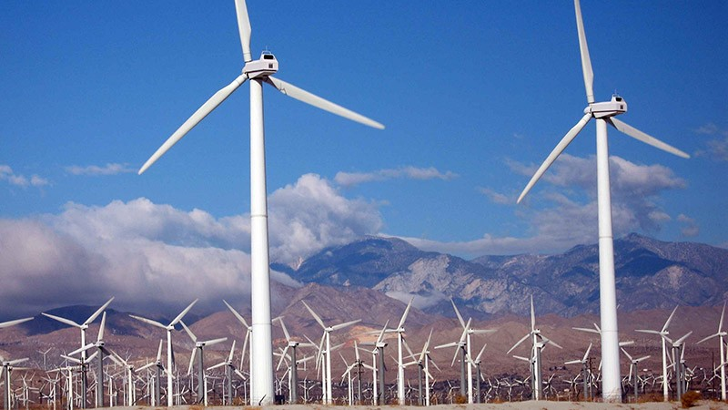
Wind energy solution to climate change
Employ as many wind turbines as economically-feasible in unpopulated areas of land and coastal lines
Ensure these open areas efficiently produce winds strong enough to turn the turbines consistently
Shift renewable energy funding to increasing wind turbine numbers

Slide 12
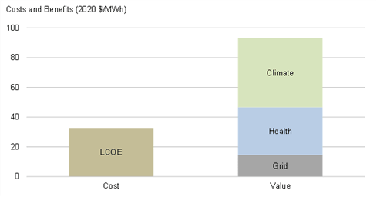
Potential outcomes of Wind Energy
Significant decrease in CO2 emissions
Wind generates 11g of CO2/kWh
Carbon footprint 90x less than coal
Reduced exposure to air pollutants linked to fossil fuels
Nitrogen oxides & sulfur dioxide are linked to asthma, lower and upper respiratory symptoms, and heart attacks
Development of interconnected wind turbines across large chunks of the country would reduce intermittency
The combined energy would establish a minimum amount of power at all times

Slide 13

Potential outcomes of wind energy Cont.
The U.S. wind sector could employ 600,000 people by 2050
Creation of 500,000 jobs over span of 30 years!
Manufacturing, installation, maintenance, and supporting services
Wind energy can strengthen rural economies
In SW Minnesota, every 50 two-MW turbine generates...
$1 million in new tax revenues
$250k for landowners

Slide 14
Works Cited
https://www.nord-lock.com/insights/knowledge/2020/offshore-floating-wind-energy/
https://www.inspirecleanenergy.com/blog/clean-energy-101/how-much-energy-does-wind-turbine-produce
https://mocomi.com/how-do-wind-turbines-work/
https://www.renewablesfirst.co.uk/windpower/windpower-learning-centre/much-power-generate-wind-turbine/
https://energyandcleanair.org/revealing-the-cost-of-air-pollution-in-real-time/
https://www.eia.gov/energyexplained/energy-and-the-environment/where-greenhouse-gases-come-from.php
https://www.energy.gov/articles/doe-releases-new-reports-highlighting-record-growth-declining-costs-wind-power
https://www.energy.gov/eere/wind/advantages-and-challenges-wind-energy
https://www.forbes.com/sites/christopherhelman/2021/04/28/how-green-is-wind-power-really-a-new-report-tallies-up-the-carbon-cost-of-renewables/?sh=357c6b2f73cd
https://www.eia.gov/energyexplained/wind/electricity-generation-from-wind.php
https://www.planete-energies.com/en/medias/close/future-wind-power
https://greengarageblog.org/24-advantages-and-disadvantages-of-wind-turbines
https://www.energy.gov/eere/wind/articles/how-wind-energy-can-help-us-breathe-easier

